Slide 1

6MMCS001W Mobile User Experience Lecture
Mobile design principles ● Gamification

Slide 2
Gamification in Mobile Apps

Slide 3
Gamification
A term introduced by O’Brien 2010 the use of game design elements in non-gaming applications and services to enhance the level of user’s engagement and motivation
O’Brien: Get Ready for the Decade of Gamification. San Jose Mercury News. October 24, 2010, available at: http://goo.gl/4XQp2c, last accessed on 19/04/2016.

Slide 4
Gamification
game mechanics is the use of elements such as points, badges and leaderboards that are common to many games
experience design is the journey players take with elements such as game play, play space and story line
gamification is a method to digitally engage, rather than personally engage, meaning that players interact with computers, smartphones, wearable monitors or other digital devices, rather than physically engaging with a other people
the goal of gamification is to motivate people to change behaviours or develop skills, or to drive innovation
gamification focuses on enabling players to achieve their goals. When organizational goals are aligned with player goals, the organization achieves its goals as a consequence of players achieving their goals.
Gamification is the concept of using
game mechanics
and experience design
to digitally engage and
motivate people
to achieve their goals
[B. Burke (2014) http://blogs.gartner.com/brian_burke/ 2014/04/04/gartner-redefines-gamification/]
Gamification taps into the basic desires and needs of the users impulses which revolve around the idea of status and achievement.

Slide 5
Differences in terms is due to the design goals
Andrezej Marczewki’s diagram [Mar-czewski 2013]
 | Game Thinking | Game Elements | Game Play | Just for Fun
Game design
Gamification
Serious Game / Simulation
Game

Slide 6
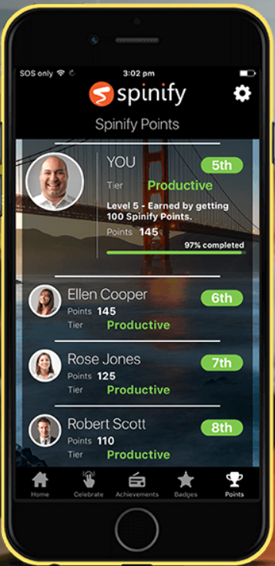
Enhance team motivation
Progress towards company targets
Visibility of performance
Celebrating success
Recognition
Reward

Slide 7
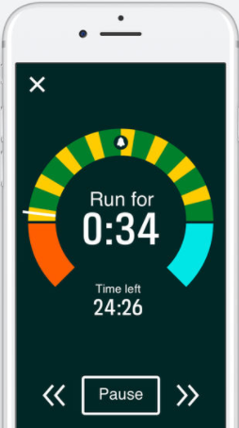

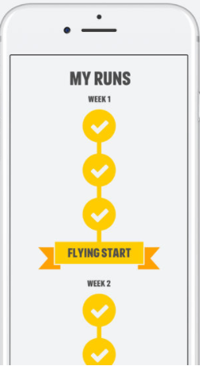
Health aps- Coach to 5K

Slide 8
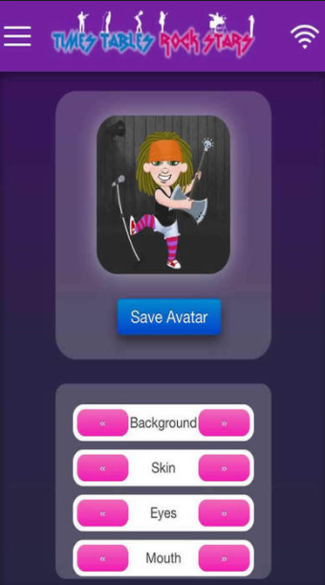
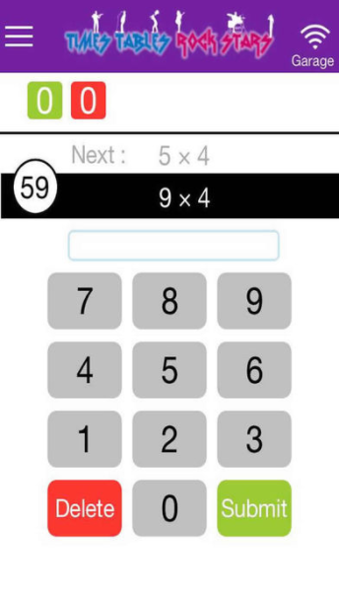

TT Rock Stars makes times tables fun

Slide 9
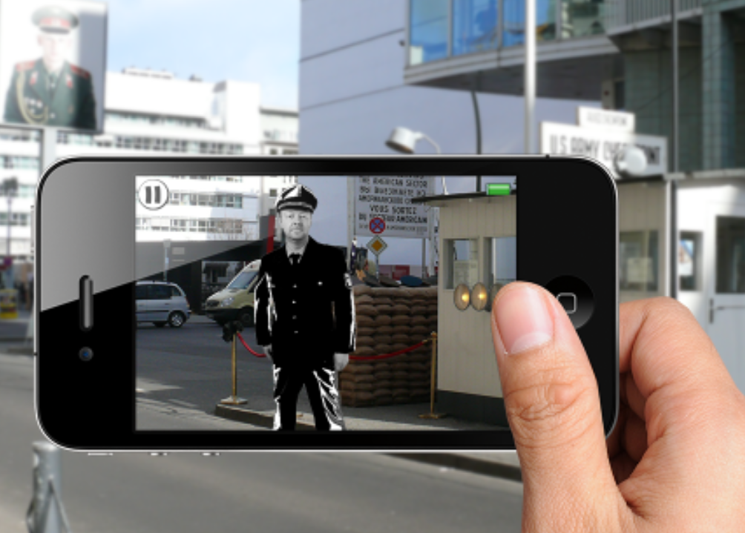
Gamification in tourism
Augmented Reality Game ‘Fall of the Wall (Berlin)’ | ©Sprylab | tripventure.net Please find a video to Location-based Augmented Reality Games from Tripventure

Slide 10


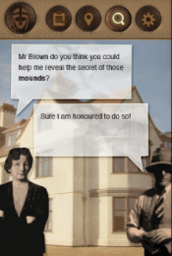
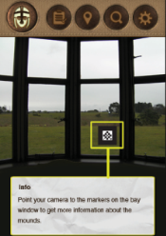
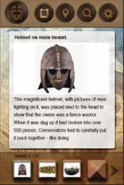
Gamification in archaeology - Sutton Hoo Mobile AR
https://www.westminster.ac.uk/__data/assets/pdf_file/0020/142490/Project-11-Sutton-Hoo-project_new.pdf
A. Angelopoulou, D. Economou, V. Bouki, A. Psarrou, L. Jin, C. Pritchard, F. Kolyda (2012) Mobile Augmented Reality for Cultural Heritage, Mobile Wireless Middleware, Operating Systems, and Applications Lecture Notes of the Institute for Computer Sciences, Social Informatics and Telecommunications Engineering Volume 93, 2012, pp 15-22

Slide 11
Techniques to Effectively Gamify a Mobile App
Set objectives
Add value
Ingrained in the ecosystem
Keep it simple
Build sharing loops
Quick rewards

